Slide 1


Understanding Sales Performance and Customer Behavior
This presentation will dive into a comprehensive analysis of sales performance and customer behavior using the SampleSuperstore dataset. We'll leverage Python, Pandas, Matplotlib, and Jupyter Notebook to uncover valuable insights that can inform business strategy.
Sonali Subhasmita Das

Slide 2
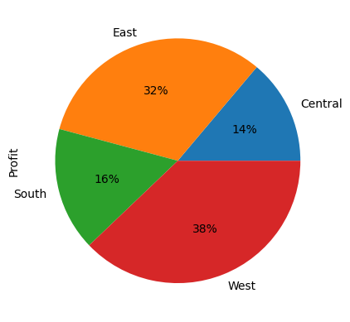
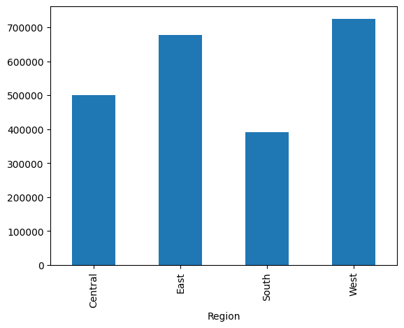
Introduction
In this presentation, we'll explore the Superstore dataset to gain a deeper understanding of sales trends and customer preferences. Using a variety of analytical techniques, we'll uncover valuable insights that can help optimize business operations and drive growth.

Slide 3

Data Overview
1
Data Source
2
Key Variables
3
Data Cleaning and Preprocessing
The Superstore dataset includes comprehensive information on sales, orders, and customer demographics.
The dataset contains details such as ship mode, segment, country, city, region, category, sub-category, and sales, quantity, and discount information.
We'll ensure the data is clean, consistent, and ready for analysis by addressing any missing values, outliers, or formatting issues.

Slide 4
Descriptive Statistics
Sales Overview
Customer Insights
Product Performance
We examined the overall sales trends, including
By analyzing customer demographics, we'll identify the most profitable customer segments and uncover patterns in their purchasing behavior.
We'll evaluate the best-selling products, identify top-performing categories and subcategories, and assess the impact of discounts on sales.
Total Sales: 2296195.59
Average Order Value: 230.14

Slide 5

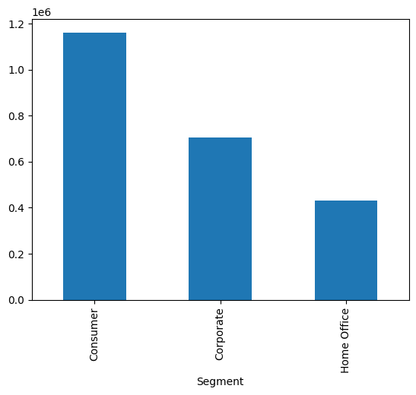
Customer Segmentation
1
Segment Identification
Using clustering algorithms, we'll identify distinct customer segments based on sales.
2
Customer Segments based on Total Purchase Amount:
Consumer High-value
Corporate Medium-value
Home Office Low-value
3
Targeted Strategies
With a deep understanding of each segment, we can develop tailored marketing and sales strategies to better serve their Consumer requirements.

Slide 6
Product Analysis
Best-Selling Products
Product Profitability
We'll identify the top-selling products across different categories , and analyze the factors contributing to their success.
By examining profit margins, and sales volumes, we can determine the most profitable products and comes under the category "Technology".
Product Trends
Product Recommendations
Analyzing sales patterns over time will allow us to detect emerging trends and anticipate changes in customer preferences.
Based on our findings, we can provide recommendations for product development, inventory management, and cross-selling opportunities. The product can be Phones as it's our top selling product.

Slide 7




Recommendations
Data-Driven Strategies
Targeted Campaigns
Inventory Optimization
Customer-Centric Approach
Leverage the insights from our analysis to develop data-driven strategies for improving sales performance and customer engagement.
Implement tailored marketing campaigns and promotional offers to reach and retain the most valuable customer segments.
Optimize product mix and inventory levels based on demand forecasts and profitability analysis to improve operational efficiency.
Enhance the customer experience by addressing their specific needs and preferences identified through our segmentation analysis.

Slide 8
Conclusion
Key Insights
Actionable Recommendations
Identified the most profitable customer segments
Discovered top
Selling products and drivers of profitability
Detected seasonal and long-term sales trends
Implement targeted marketing campaigns to reach key segments
Optimize product mix and inventory based on demand forecasts
Enhance the customer experience to drive loyalty and repeat business

